Slide 1

University Teaching 101
Beth Kania-Gosche, PhD

Slide 2

Today’s essential question
How do you effectively teach at the university level?

Slide 3
Why are you teaching?
Write it down and share with someone around you.
Notes:
Find your why to combat burnout

Slide 4
Why are your students in the class?
Is it required?
Is it an elective?
General education?
Notes:
Your students are not you.

Slide 5
If students wanted to learn the course content, they would already know it because they can find the information online.

Slide 6
Your students are not you.
Honor their differences and experiences.
What are some differences between your students and yourself?

Slide 7
What are your course learning outcomes?
Do students know what they are?
Are they written in a way students understand?
Do students know the real world consequences for failing to meet the standard?
Are they aligned with your assessments?

Slide 8
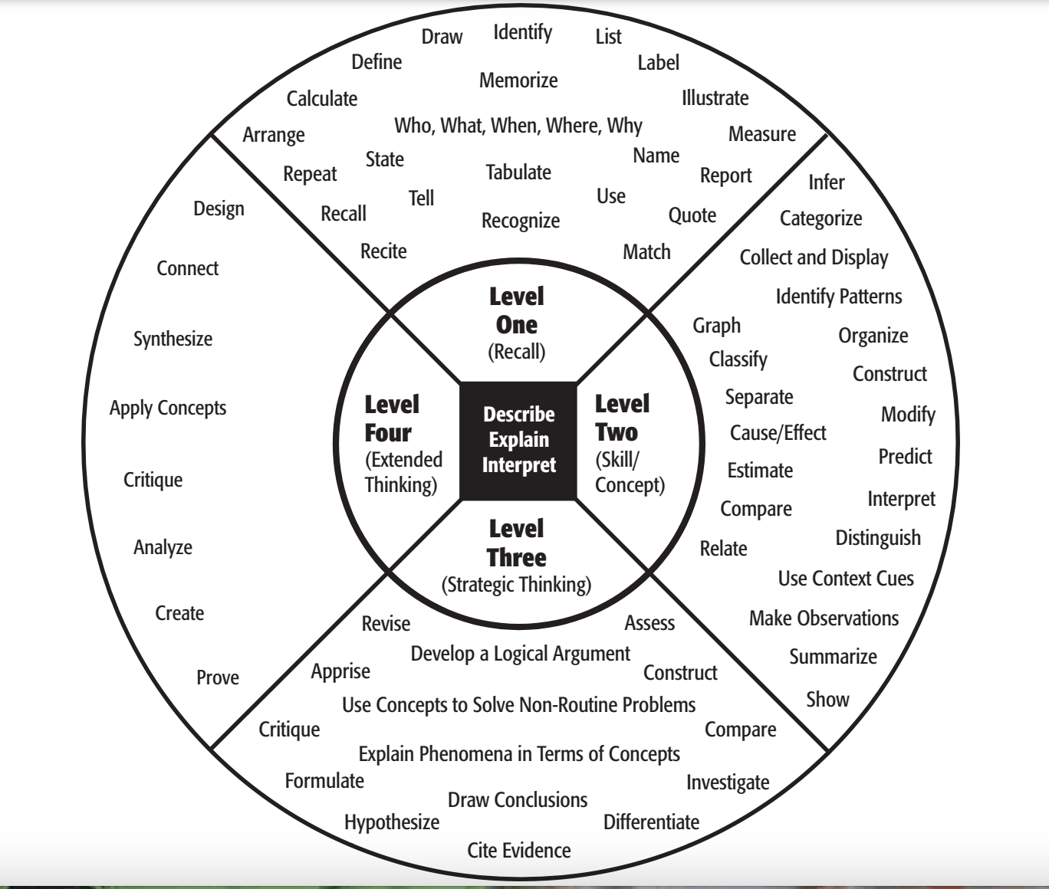
Have measurable outcomes!
Use Webb’s Depth of Knowledge to increase rigor.
List one outcome you could have for your course.

Slide 9
It is necessary to assess the outcome to make sure learning is happening!
How do you assess the outcome?
Notes:
Like running an experiment without collecting data

Slide 10
Assessment
Formative
Just in time
Feedback, not grade
Efficient, specific
Provide resources
Summative
Formal
Multiple outcomes assessed
High stakes
Notes:
On which are students more likely to cheat?
Formative (chef tastes the soup), summative (guests taste the soup)

Slide 11
Assessment Process
Identify learning outcomes in student-friendly language
Task analysis
Chunking content/skills
Examine data before teaching next session
1
3
5
2
4
6
Align summative assessment that mirrors real life tasks with clear criteria
Align formative assessment to each
Provide feedback and resources to students

Slide 12

Effective Teaching Checklist
Notes:
Look this over. What questions do you have

Slide 13
Teaching, often called an “art and a science”
Content knowledge
People knowledge
Effective teaching
Notes:
Emotional IQ

Slide 14
Let go of perfectionism
Limited resources
Continuous improvement, circumstances constantly change

Slide 15
What questions do you have?
bkaniagosche@mst.edu
  Email me if you would like to observe.

Slide 16
Credits
Special thanks to all the people who made and released these awesome resources for free:
Presentation template by SlidesCarnival
Illustrations by Sergei Tikhonov
Photographs by Unsplash

Slide 17
Presentation design
This presentation uses the following typographies:
Titles: Raleway
Body copy: Barlow
Download for free at:
https://www.fontsquirrel.com/fonts/raleway
https://www.fontsquirrel.com/fonts/barlow
You don’t need to keep this slide in your presentation. It’s only here to serve you as a design guide if you need to create new slides or download the fonts to edit the presentation in PowerPoint®

Slide 18

Free templates for all your presentation needs
For PowerPoint and Google Slides
100% free for personal or commercial use
Ready to use, professional and customizable
Blow your audience away with attractive visuals

